Slide 1
STUDENT ANXIETY
Interventions for the Emerging Epidemic
Paul Foxman, Ph.D.
www.drfoxman.com
paulfoxman@aol.com
Notes:
My training: insight but no CBT, DBT, ERP, RET, ACT, TFT, NLP, EFT (freedom technique…tapping for success and abundance), MSC (Mindfulness Self-Compassion…research shows reduces anx, depression and helps maintain diet and exercise routines), EMDR, MBSR, ABBT, Solution Focused Rx
Freud: “insight alone is like giving a starving man a dinner menu only”

Slide 2
ANXIETY DISORDERS
1. Anxiety Disorders
  Separation Anxiety Disorder
  Selective Mutism
  Panic Disorder/Agoraphobia
  Generalized Anxiety Disorder
  Social Anxiety Disorder
  Specific Phobias
  Anxiety Due to Another Medical Condition
2. Obsessive-Compulsive Disorders
3. Trauma- & Stressor-Related Disorders
Notes:
DSM V changes: 3 categories.
Anx Disorders (added Selective Mutism)
OCD and related disorders (trichotillomania, excoriation, hoarding)
Trauma and stressor related disorders
Difference between normal and abnormal anxiety: symptom frequency, intensity and duration (e.g. separation anxiety to be discussed next)
CO-EXISTING CONDITIONS:
Depression: new evidence temporal relationship w anx (dep children may appear agitated, hyperactive, aggressive, negative, antisocial)
Medical: allergies, obesity (5 million children), diabetes, celiac, immune deficiency, ventricular neuritis, thyroid deficiency
Adjustment disorders
DIAGNOSTIC CONFUSION (What Anxiety is NOT):
Behavior disorders, e.g. ODD (psychoRx, behavioral Rx)
ADHD (non-stimulant med: Strattera)
Autism spectrum disorders (formerly high functioning Asperger’s Disorder)
?Bipolar disorder (50% diagnosed don’t have it, only 2.6% under 18) can treat with stability (bedtime, orderly home, clear limits, low stress, diet)

Slide 3
CHOOSE 3 FOR TODAY
Separation Anxiety
Panic Anxiety
Worry
Social Anxiety
Trauma

Slide 4
GENERALIZED ANXIETY DISORDER
Diagnosis
Normal vs abnormal worry
Why do we worry?
What will replace worry?
Treatment strategies
Notes:
Worry: DSM: “apprehensive expectation”, excessive, unreasonable, negative (What if I have a great day?… pass that test?)
Purpose or function: attempts to cope with uncertainty, habit (functional autonomy)
CBT: thoughts precede emotions (Burns, Beck, Ellis)
Types of worry (harmless and tragic): Silverstein poem

Slide 5

“NORMAL” WORRIES (7-15)
School performance
Appearance
Social acceptance
Death of a parent
Friends
Global (hunger, poverty, violence, nuclear destruction)
Notes:
From a large scale study of 5,000 U.S. children in multiple cities

Slide 6
DEFINITION OF WORRY
  Apprehensive expectation about 1 or more things (school, health, work) occurring more days than not for 6 months or more
  Recognized as excessive and unreasonable (not reality based)

Slide 7

WORRY REPLACEMENTS
  Energy
  Optimism
  Joy
  Relaxed
  “Presence”
  Trust/Faith
  Gratitude
  Acceptance

Slide 8
STRATEGIES FOR WORRY
Reframing “harmless” worry
Reality testing “tragic” worry
Externalizing worry
Prescribing the symptom
Positive affirmations
Mindfulness approach
Solution focus (Miracle Question)
Letter from the Future
“Playing the Part”
Notes:
Silverstein poem (2 types of worry)
Externalize: Group exercise—worry paper, show Worry Dolls
Prescribe the symptom: Play “Don’t Worry” CD (8 minutes)
Retrain with Mindfulness Attitude (Observing Ego): observing without judging or identifying (“Don’t believe everything you think,” “It’s just a thought,” “That’s my worry habit,” “A thought is not a fact”)
Solution focus: Miracle Question, positive alternatives (present focus, relaxed, optimistic, positive thinking, trust)
Letter from the Future (the future can effect the present): imagine a future time when problem no longer…what’s it like, what steps taken, letter from future self)

Slide 9
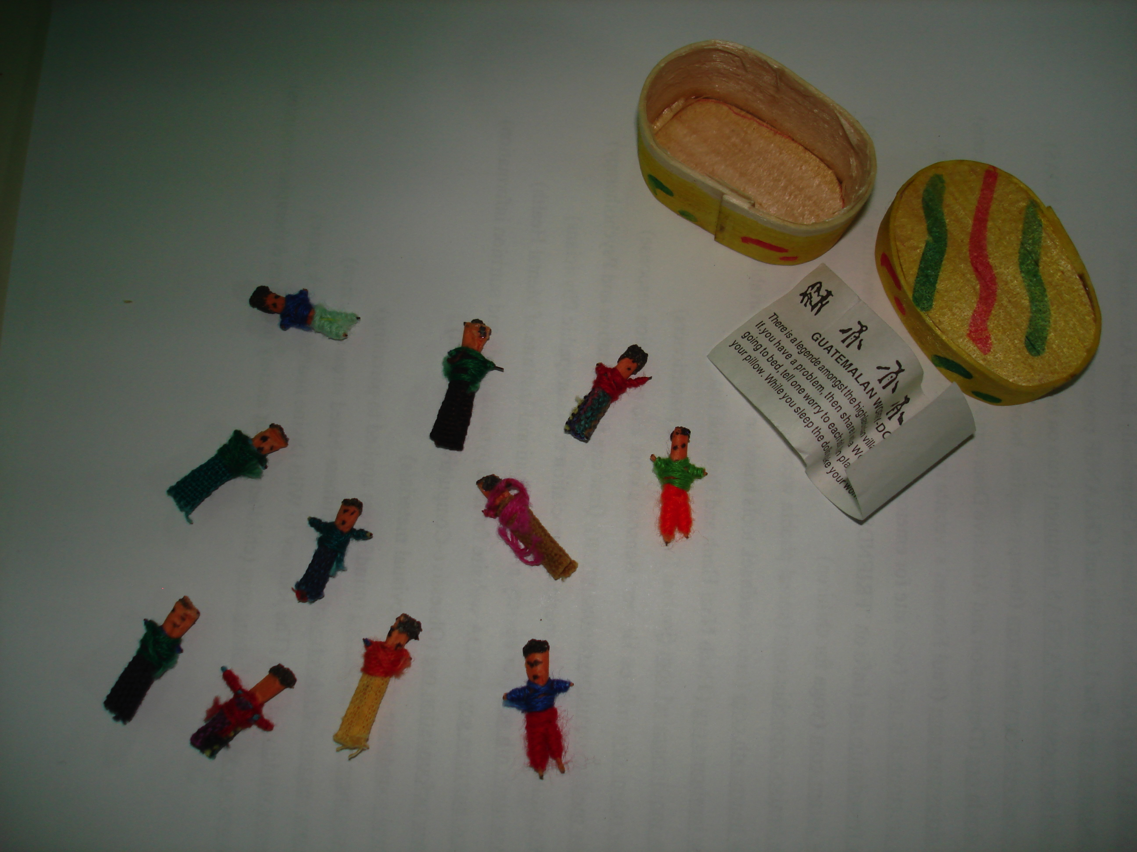
GUATEMALAN WORRY DOLLS

Slide 10
POSITIVE AFFIRMATIONS
Create a positive statement that counteracts a worry thought. Include 4 criteria:
  Present tense
  Action verb
  Self-reference
  Realistically positive
E.G: “I take care of myself and trust my health.”

Slide 11
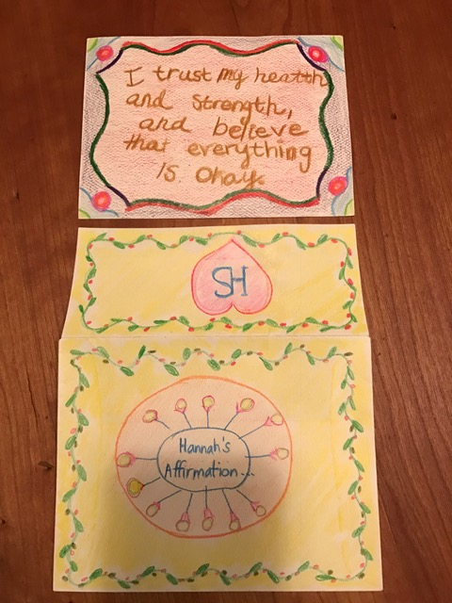
Notes:
AGE and DOB: 10 years old, 9-9-06
DATE: 11-15-16
REFERRED BY: Dr. Foxman’s book, The Worried Child
PP: Anxiety/worry
HX OF PP: Stomach issues and somatic symptoms for during past year, recently diagnosed by PCP as anxiety based. First panic attack summer 2016.
MENTAL HEALTH RX:
No prior therapy
CURRENT SX
Stomach aches/GI sx
Heart palpitations
Worry about many things, especially health
Reciprocal relationship between physical symptoms and worry (e.g. fear of dying/life threatening illness)
Highly reactive to changes and transitions
Sleep issue (night waking)
RECENT STRESS:
Multiple moves and school changes (6 schools since preschool)
Moved from Hartford, CT to VT two years ago
WISHES:
“To be able to help my anxiety, not be anxious all the time”
“To do what I really want to do when I want to do it”
“To be relaxed and calm and not have any worries”

Slide 12
MIRACLE QUESTION
"When you leave my office today, imagine that a miracle occurs. As a result of the miracle you no longer have the anxiety problem we have been discussing. However, the miracle occurs tonight while you are sleeping so you won't know that it has happened until you wake up tomorrow morning. What will be different, what will you notice and how will you know that you have changed?"
Notes:
Group exercise

Slide 13
LETTER FROM THE FUTURE
"Imagine that you are at a future point in time, when you are older and no longer have the anxiety we have been discussing. Write a letter from your future self to your current self describing what you are doing, what it's like and what steps you took to get there. Include what you learned that helped you get there. End with some wise advice to yourself."

Slide 14
MINDFULNESS: WITNESSING
Notice and label your thoughts (and feelings) without judgment:
  “That’s just my worry habit.”
  “A thought is not a fact.”
  “It’s not happening now.”
  “What are my behavior choices?”
  “Don’t believe everything you think.”

Slide 15


Slide 16
PLAYING THE PART
"Imagine that you are auditioning for a part in a play. The character is a relaxed, confident person who (add other qualities, e.g. enjoys social interaction). To get the part you will need to be convincing. What behaviors, mannerisms, style of dress and other qualities will you need to practice. Let’s try practicing right now."
Notes:
Group exercise…visualization
Virtual reality (imaginal practice),visualization reheasal
Whistle a Happy Tune (song from Richard Rogers and Oscar Hammerstein’s, The King and I): “Make believe you’re brave and the trick may take you far; You may be as brave as you make believe you are.”

Slide 17

SOCIAL PHOBIA
Diagnosis
Treatment
Notes:
Diagnosis: Concerns about judgment & scrutiny, projection of low SE
Less than 1% Selective Mutism, typical onset 3-5
Discuss The Introvert Advantage (Laney) concept
CBT: 70% effective with ↓ relapse
ADOLESCENT GROUP: Andrew (handsome, music), Melissa (bright, creative, 3 wishes: love relat, nature, never worry again), Kelly (attractive, art student), Brian (baseball cap, 3 wishes: not be anx & depr, girlfriend, direction in life), Rich (PD with Ag)
GROUP THERAPY ACTIVITIES: mutual interview, role play, eye contact
AUDIENCE EXERCISE: eye contact
VIDEO: Challenge Day
WEB SITE: healsocialphobia.com
NEXT SLIDE: Social Anxiety Strategies

Slide 18
SOCIAL ANXIETY DIAGNOSIS
Persistent fear of scrutiny or negative judgment
Distressing but recognized as unreasonable
Phobic situations can be generalized or specific
Phobic situations are avoided or “endured”
Interferes with life & normal routines
Notes:
Before 1980 (DSM III), avoidance was primary criterion for diagnosing social anxiety (3%), but changed in 1994 (DSM IV) to include “enduring” social situations (13%).

Slide 19
PHOBIC SITUATIONS
Public speaking
Interviews
Playing music or singing to audience
Athletic performance
Speech & language (selective mutism)
Dating (intimacy, sex)
Public restrooms (paruresis)
Notes:
Paruresis is a form of social anxiety disorder found in both sexes. Known by different names, such as pee shy, shy kidney or bashful bladder, this condition involves difficulty relaxing enough to urinate in places like public restrooms where others might hear. Rx begins with suggestions (running water or fan) followed by relaxation training and CBT.
Any situation involving potential scrutiny or judgment by other people
See page 86 in PESI book for behavior therapy with Selective Mutism

Slide 20
BODY REACTIONS
Increased heart rate
Blushing
Breathing changes (shallow, irregular)
Dizziness or feeling faint
Constipation or diarrhea
Sweating
Trembling or shaking
Blurred or tunnel vision
Fear performance will be effected by above
Notes:
Self-consciousness about these anxiety symptoms…fear the symptoms will show.
Pre-occupied with and distracted by signs and symptoms of anxiety

Slide 21
IMPACT OF SOCIAL ANXIETY
Lower academic achievement
Loneliness and isolation
Depression
Suicide
Substance abuse
Notes:
Discuss why some young people have social anxiety: from what does it stem? Genetic (shy temperament), social humiliation?
SE source

Slide 22
SOCIAL ANXIETY STRATEGIES
New skills & talents to raise self-esteem
Encourage and praise social interaction
Job or volunteer work for shy teens
Time with outgoing peers
Mentoring programs
Teach communication & social skills
Notes:
New skills/talents: Andrew case (music)

Slide 23
GROUP RX ACTIVITIES
Mutual interviews
Relaxation practice
Eye contact practice
Role play
Show-and-tell (e.g. favorite song)
Self-esteem building (compliments)
Exposure assignments

Slide 24


Slide 25
POST-TRAUMATIC STRESS DISORDER
Trauma definition
Types of trauma
Symptoms
Treatment goals
Treatment strategies
Notes:
TRAUMA:
PREVALENCE:
Up to 50% of child/adolescents (total 74 million) will experience at least 1 trauma by age 18 (but will not necessarily develop PTSD)
85% children in poor, urban neighborhoods witness violence (66% actually hurt)
Most children/adolescents with PTSD not recognized and receive no help
ACE (Adverse Childhood Experiences) study (1998): 17,421 Kaiser members assessed for hx of ACE (emotional or physical abuse, contact sexual abuse, household criminal activity. 64% had at least one ACE (28% physical abuse) and 22% had 3 or more.
SAMHSA (SA & MH Services Admin) 2011 study (14,773 children): loss of caregiver (48%), witnessing domestic violence (47%), impaired caregiver (44%).
SAMHSA 2011 of 7,819 children found 9% had PTSD, ADHD (39%), mood disorders (38%), ODD (26%)
Based on SAMHSA data, in response to trauma:
Preschool children more likely to act out aggressively
School age children more likely to show mood disturbances
Teens more likely to manifest anxiety and isolation
2017: 368 gymnasts (mostly preteen and teen girls) have alleged sexual abuse by coaches, gym owners and other adults working in the gymnastics world. 115 adults were named from respected mentors to novices and in every part of U.S. What about boy scouts, H.S. and college sports, recreational centers, summer camps, church?
DEVELOPMENTAL TRAUMA: neglect, poverty, homelessness, abandonment, lack of comforting, unpredictability, disabled P’s (S/A, untreated MI), narcissistic P’s, immature P’s, witnessing violence

Slide 26
TRAUMA DIAGNOSIS
“Exposure to a stressful event involving actual or threatened death, serious injury or sexual violence”
20 symptoms in 4 groups:
  Re-experiencing/intrusion
  Avoidance
  Negative cognitions or mood
  Arousal
Recent trend: “Developmental Trauma”
Notes:
TYPES OF TRAUMA: sexual abuse, physical abuse, car accidents, domestic violence, community & school violence, medical trauma, natural disasters, suicides and other traumatic losses.

Slide 27
PTSD SYMPTOMS
Re-experiencing/Intrusion: reactivity to reminders, trauma play or reenactment
Avoidance: thoughts, feelings, external cues
Negative cognitions/mood: depression, self-blame, survival guilt, defensive amnesia
Arousal: hypervigilance, difficulty relaxing, sleep disturbance, irritability, aggression
Notes:
SYMPTOMS & NEUROBIOLOGY: WE LEAVE OUR BODIES AS AN INVOLUNTARY COPING REACTION TO NEUROMUSCULAR TENSION & PAIN & SHAME, SO RX IS ABOUT RE-ENTERING/RE-INHABITING AND FINDING PEACE IN THE BODY. shuttjng down/avoidance/numbing (parasympathetic), high arousal/hypervigilance (re-experiencing, “kindling” (sympathetic)
SENSITIZATION…EMOTIONAL PROCESSING THEORY (Foa): classical conditioning of stimulus and physical fear response leading to pathological interpretation of physical response. Similar to panic anxiety: fear of the symptoms

Slide 28
ACUTE STRESS DISORDER
(PTSD symptoms within 30 days of trauma)
Crisis intervention:
Get facts
Establish safety
Normalize feelings
Group appropriate
Notes:
Critical Incident Stress Debriefing

Slide 29
PTSD THERAPY GOALS
Reduce re-experiencing
  exposure to separate anxiety-memory
Reduce arousal symptoms
  relaxation training
Reduce avoidance
  exposure
Correct negative cognitions
  self-blame
  survivor guilt

Slide 30
PTSD THERAPY STRATEGIES
Safe exposure
  -Talk (“process” gradually from outside in)
  -Play/art/storytelling
  -EMDR
  -Resourcing
Relaxation training & somatic healing
Sanctuary approach for developmental trauma
Tips for parents
Notes:
Telling the story vs feeling/experiencing the story
TALKING is reliving/desensitizing in context of safety & trust
EMDR (Greenwald) creative bilateral brain stimulation while recalling trauma memories and feelings
SOMATIC approach:
Van der Kolk 1994 groundbreaking study: 10 subjects agreed to PET scans as they recalled traumatic experience. Brain area associated with narrative memory and verbal expression became inhibited and amydala (limbic system emotional center) became activated. Conclusion: began with memory that could be put into words but quickly lost ability to put language to intense emotions/body sensations.
Impact of trauma on neuro-musculature (neuromuscular shock) may not release in talk therapy. Need body work to reduce embedded hyperarousal: Bessel van der Kolk (Frontiers of Trauma Treatment): “Traumatic experiences alter people’s relationship to their bodies in ways that leave them feeling uptight, helpless, disconnected, hurt, on edge, frantic, and at odds with themselves and their environment”
SOMATIC RX:
YOGA (Bo Forbes: “Fortunately, the neural pathways to relaxation exist in each one of us. Those pathways need to be discovered and activated to alter the state of the nervous system.”
OTHER BODY WORK APPROACHES (reconnecting, re-inhabiting, feeling)
• Martial arts (e.g. Aikido, T’ai chi, Karate)
• Dance
• Exercise, physical movement and outdoor recreational activities (see Chapter 3) • Flow activities (see Chapter 3)
• Playing music and singing
• Breathing practices
DEVELOPMENTAL TRAUMA:
Sanctuary Approach emphasizing Maslow’s Hierarchy of Needs (food, shelter, love, health care, safety, relaxation)
Therapeutic On-the-Spot Crisis Intervention (to see a different way to teach/care/prepare for life)
Wrap-around services
Relationship with people who care
3 “helper” styles: educator, fire-fighter, abuser
RESOURCING: Identify an inner resource (e.g safe place visualization, saying) to use when anxious in Rx. “You have been through a lot and survived…what gave you the strength to go on?”
PROLONGED EXPOSURE THERAPY (Foa): activate fear by accessing trauma memory and associated feelings. Prolonged exposure demonstrates that danger no longer present and this new information gradually alters perception and arousal. 3 components: Education, repeated imaginal reliving, repeated in-vivo exposure (with hierarchy, SUDS, repeat to habituation). Process similar to ERP.
TIPS FOR PARENTS (Foxman)

